Slide 1

Configuration Driven Data Pipelines
RLAM SUMMER HACKATHON
11.07.2025

Slide 2






Sudhakar Sivananaindha
Preveen Selwyn
THE HACKATHON
TEAM
Praj Rathore
Thiru Srinivasan
Namith Chandrashekharpillai
Suraj Kumbhar

Slide 3

Agenda
INTRODUCTION
PROBLEM STATEMENT
A BIT ABOUT FRAMEWORK
PROJECT OVERVIEW
DEMO
WHAT’S NEXT
CLOSING

Slide 4

PROBLEM
Common Data Ingestion Patterns for Structured, Unstructured and Semi-Structured data
Expensive Data Factories
Running + Dev Time
Cannot Simulate Locally
Scalability: Limited to existing Tasks or more infra

Slide 5



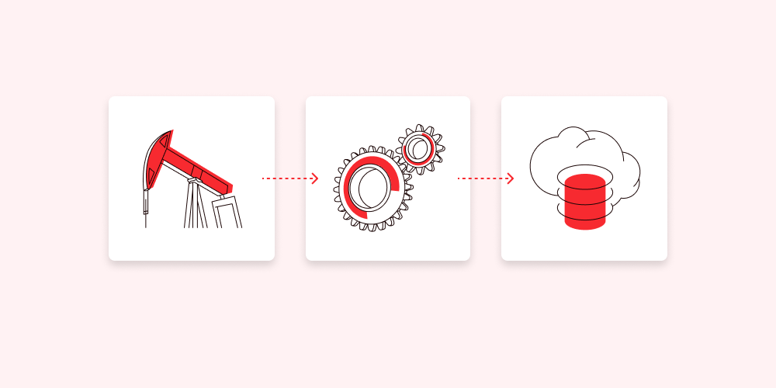

The Framework
CONFIGURATION
PIPELINE
SAVE ££s

Slide 6
Configuration
Easy Integrations to any API Source
Version Controlled
Can be done by Support: No Devs and Architects
Delivery to Multiple Destinations
Straightforward Transformation and Enrichments
Easy Scheduling
Event Driven

Slide 7





PIPELINE
Created dynamically based on configuration
Can manage GBs of data.
Uses Apache Airflow hosted in Kubernetes Cluster.
Load data to Snowflake Tables or Snowflake Stages or both, just by Configuration.
Easy to setup locally for dev & test.
Auto Deployments using Git Sync to Airflow
CLOUD AGNOSTIC

Slide 8
Current Cost Analysis
* Data extracted for last 30 days on 10.07.2025

Slide 9
ADF: £156,911.56 Event HUB: £669.60 AppS: £79,910.81
£237,491

Slide 10
Kubernetes Cost
 | DEV (Not Required) | TEST | PRE | PROD
VMs | 1 | 2 | 3 | 3
CORES/VM | 4 vCPU | 4 vCPU | 8 vCPU | 8 vCPU
RAM/VM | 2 | 16 | 32 GB | 32 GB
SSD | 128 GB (Standard SSD) | 128 GB * 3 (Standard SSD) | 128 GB * 3 (Standard SSD) | 128 GB * 3 (Premium SSD)
YEARLY COST | £1,464 | £2,100 | £4,638 | £7,920
With Professional Direct Support (£728.15/month) | NA | NA | NA | £16,658
* Calculated using Azure Calculator in July 2025

